Slide 1
🏚👻
ESCAPING THE
HAUNTED MANSION
A Text-Based Adventure Game in C
"Six rooms. Two puzzles. One way out."
💻 CSE115 – Programming Language I
Submitted To: M. Shifat-E-Rabbi Dept. of Electrical and Computer Engineering
P R E S E N T E R O R D E R
1
👤 Syed Mohammad Aqif Reza
2
👤 Humayra Mahjuba Zaman
3
👤 Tilika Biswas
CSE115 | SECTION 4 | Group - 1 | Syed Mohammad Aqif Reza (2622644042) | Tilika Biswas (2621946042) | Humayra Mahjuba Zaman (2621387042)
Notes:
OPENING HOOK (say this before anything else — not "good morning"): "Imagine you're trapped inside a six-room mansion. You have no map, your health is limited, and the only way out is hidden behind two puzzles." "We turned that scenario into a C program." Then introduce the team and move into the game concept.

Slide 2
GAME CONCEPT
Presented By: Syed Mohammad Aqif Reza
🗺️
Game Concept
Six connected rooms, one clear objective, and a loop that repeats until you escape — or don't.
🕹️ Genre: Text-Based Interactive Adventure Game
💻 Language: C Programming Language
🔁 Core Loop: Explore → Collect → Solve → Survive → Escape
🔑 Explore six rooms, solve two puzzles, survive the ghosts, and return to the Entrance Hall with the Master Key.
G A M E F L O W
🚪
🛋
🔪
📚
🔦
🔑
Entrance
Hall
Living
Room
Kitchen
Library
Basement
Secret
Chamber
🎯 GAMEPLAY ELEMENTS
🚶 Exploration
🎒 Item Collection
📦 Inventory
🔐 Puzzles
👻 Ghost Encounters
❤️ Health
🚪 Escape Objective
CSE115 | SECTION 4 | Group - 1 | Syed Mohammad Aqif Reza (2622644042) | Tilika Biswas (2621946042) | Humayra Mahjuba Zaman (2621387042)

Slide 3
HOW IT WORKS
Presented By: Syed Mohammad Aqif Reza
🧭
How the Game Works
Progression depends on required items, puzzle solutions, health, and player decisions.
P R O G R E S S I O N P A T H
D A N G E R P A T H
START → Entrance Hall
👻 Ghost Encounter — Kitchen / Basement
Explore & Collect Flashlight
Health Decreases (Random Damage)
Solve Library Puzzle → Silver Key
Use Medicine (+20) or Med Kit (+35)
Access Basement & Secret Chamber
Health Reaches 0
Solve Chamber Puzzle → Master Key
💀 GAME OVER
Return to Entrance Hall
🏆 WIN — Escape the Mansion
CSE115 | SECTION 4 | Group - 1 | Syed Mohammad Aqif Reza (2622644042) | Tilika Biswas (2621946042) | Humayra Mahjuba Zaman (2621387042)

Slide 4
PROGRAM FOUNDATION
Presented By: Syed Mohammad Aqif Reza
🏛️
Program Foundation
The structures and initialization that every other system in the game builds on.
structures.h
👤 Player State
typedef struct {
char name[50], description[300], item[30];
int exits[4], itemTaken, puzzle, puzzleSolved;
int ghost, ghostDefeated, damage;
} Room;
// Key functions:
// menu() · setRoom() · initializeRooms()
// initializePlayer() · showRoom()
• Name
• Health
• Score
• Current room
• Inventory
📋 Menu & Room Display
• Function prototypes declared for every gameplay system
• Menu-driven loop reads the player's choice each turn
• Room display prints name, description & exits
Structures → Initialization → Room Display → Player Interaction
CSE115 | SECTION 4 | Group - 1 | Syed Mohammad Aqif Reza (2622644042) | Tilika Biswas (2621946042) | Humayra Mahjuba Zaman (2621387042)
Notes:
WHY STRUCTURES? We needed each room to store its exits, item, puzzle and ghost state together, and each player to keep name/health/score/location/inventory in one place. That's exactly what typedef struct gives us.

Slide 5
GAMEPLAY SYSTEMS
Presented By: Humayra Mahjuba Zaman
🎮
Gameplay Systems
Movement, danger, and recovery — the systems that decide whether the player survives.
🚶
👻
💊
MOVEMENT
GHOST SYSTEM
HEALING
Check exit → Check required item → Move player
Enter danger room → Random damage → Update health
Medicine +20 · Med Kit +35
Basement needs the Flashlight; Secret Chamber needs the Silver Key.
Random damage during Kitchen & Basement encounters.
Capped at 100 max health; item removed after use.
gameplay.c
if (r[next].ghost && !r[next].ghostDefeated) {
damage = r[next].damage + rand() % 6;
p->health -= damage;
}
// What this does: damage is randomised, so encounters aren't predictable
// Key functions: movePlayer() · takeItem() · showInventory() · useHealingItem()
CSE115 | SECTION 4 | Group - 1 | Syed Mohammad Aqif Reza (2622644042) | Tilika Biswas (2621946042) | Humayra Mahjuba Zaman (2621387042)

Slide 6
PUZZLE & GAME CONTROL
Presented By: Tilika Biswas
🧩
Puzzles → Keys → Escape
The logic that gates progress and decides whether the player escapes.
📚 LIBRARY → Keyboard Book Chair → ✅ Correct → 🔑 SILVER KEY
🕯️ SECRET CHAMBER → 1 3 5 7 ? → ✅ Correct → 🔑 MASTER KEY
🚪 ENTRANCE HALL → 🏆 ESCAPE THE MANSION
puzzles.c
if (answer == 1) {
x->puzzleSolved = 1;
strcpy(x->item, "Silver Key");
p->score += 20;
}
// Correct answer -> Silver Key -> +20 points
// Key functions: solvePuzzle() · hasItem() · main() — switch-case & input validation
CSE115 | SECTION 4 | Group - 1 | Syed Mohammad Aqif Reza (2622644042) | Tilika Biswas (2621946042) | Humayra Mahjuba Zaman (2621387042)

Slide 7
ARCHITECTURE
Presented By: Tilika Biswas
🏗️
How Our C Code Connects
Three sections. One shared game state — Room[] and Player flow from input to win or game over.
PLAYER
FOUNDATION
↓
Room rooms[NUM_ROOMS];
Player player;
initializeRooms(rooms);
MAIN GAME LOOP
↓
MOVEMENT
INVENTORY
PUZZLE
↓
GAMEPLAY
ROOMS
ITEMS / HEALTH
KEYS
damage = r[next].damage + rand() % 6;
p->health -= damage;
↓
GAME STATE
↓
🏆 WIN
💀 GAME OVER
PUZZLES
Room rooms[NUM_ROOMS]; Player player; → passed through every gameplay function
if (player.currentRoom == 0 &&
hasItem(&player, "Master Key"))
CSE115 | SECTION 4 | Group - 1 | Syed Mohammad Aqif Reza (2622644042) | Tilika Biswas (2621946042) | Humayra Mahjuba Zaman (2621387042)

Slide 8
TESTING & RESULTS
Presented By: Tilika Biswas
✅
Testing & Results
Real scenarios run against the actual program — not just a list of features tested.
01
🏆 WIN Master Key obtained + return to Entrance Hall.
02
💀 GAME OVER Health reaches zero or below.
SCENARIO | EXPECTED RESULT | RESULT
Basement without Flashlight | Access denied | ✅
Wrong Library puzzle answer | No Silver Key awarded | ✅
Ghost encounter (Kitchen / Basement) | Health decreases | ✅
Use Medicine | +20 HP | ✅
Use Med Kit | +35 HP | ✅
Invalid menu input | Program continues safely | ✅
Master Key + Entrance Hall | WIN | ✅
Health reaches 0 | GAME OVER | ✅
CSE115 | SECTION 4 | Group - 1 | Syed Mohammad Aqif Reza (2622644042) | Tilika Biswas (2621946042) | Humayra Mahjuba Zaman (2621387042)

Slide 9
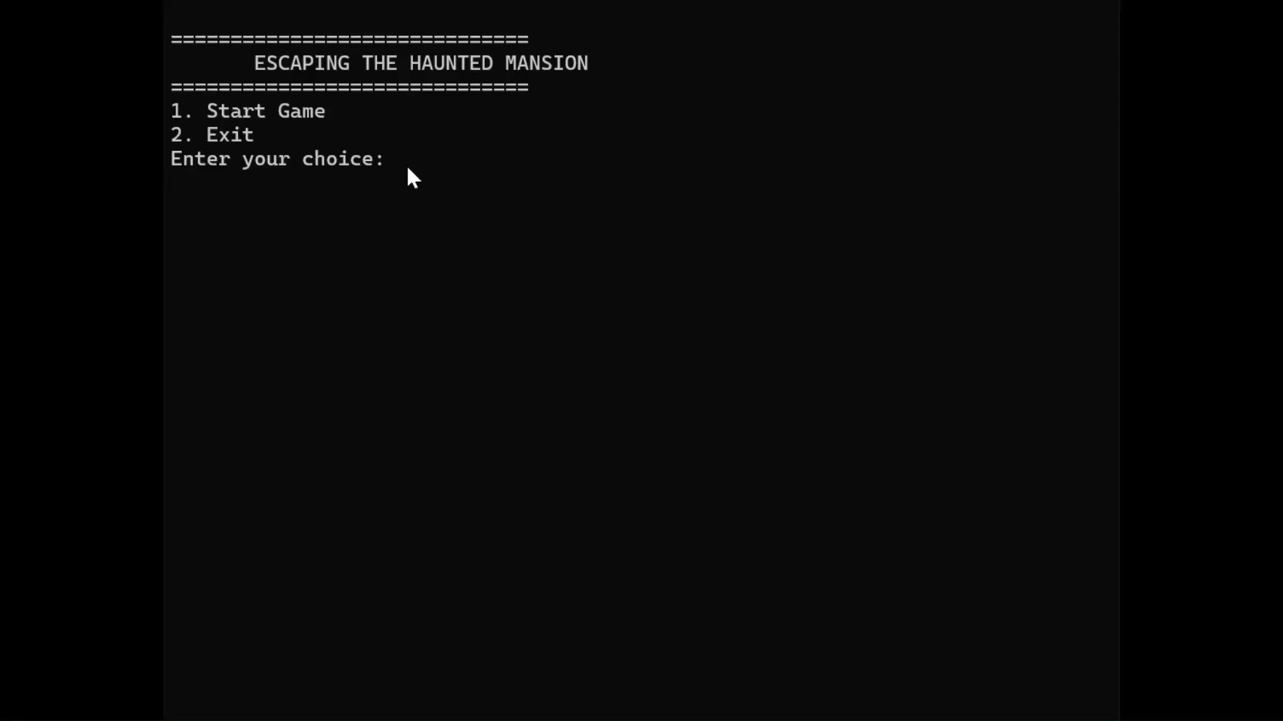
● LIVE DEMO
LIVE DEMO
Escaping the Haunted Mansion — the full escape, start to finish.
🏚️
[ LIVE TERMINAL / GAMEPLAY DEMO GOES HERE ]
CSE115 | SECTION 4 | Group - 1 | Syed Mohammad Aqif Reza (2622644042) | Tilika Biswas (2621946042) | Humayra Mahjuba Zaman (2621387042)
Notes:
This is the payoff of the presentation — walk through it as a story, not a menu tour. Only demonstrate this exact sequence; don't show every option. End on the ESCAPED message.

Slide 10
FINAL TAKEAWAY
🏆
What We Actually Built
6
2
3
2
100
2
9
Rooms
Puzzles
Key
Items
Ghost
Encounters
Max Health
Main Game
Outcomes
Gameplay
Actions
Structures • Arrays • Functions • Pointers • Loops • Conditionals • Switch-Case • Input Validation • Randomness
DID YOU ESCAPE?
6 ROOMS. 2 PUZZLES. 1 MASTER KEY. 1 WAY OUT.
Escaping the Haunted Mansion
Thank You.
CSE115 | SECTION 4 | Group - 1 | Syed Mohammad Aqif Reza (2622644042) | Tilika Biswas (2621946042) | Humayra Mahjuba Zaman (2621387042)
Notes:
Closing line: deliver 'Did you escape?' with a small pause before 'Thank you' — let it land as the button on the story, not a generic sign-off.

